Slide 1
Pandora Progress in Satellite Ground Validation: From Experimental Prototype to Global Network
A Presentation to the Sixth TEMPO Science Team Meeting
June 6-7, 2018, UCAR Center Green Campus, Boulder CO
R. Swap¹
N. Abuhassan², A. Cede^{3,4}, M. Tiefengraber³, L. Shalaby², J. Robinson², D. Santana³, M. Mueller³, C. Posch³, A. Kreuter³, M. Grunberg⁵, A. Dimov⁶, J. Herman², E. Spinei⁷ and M. Tzortziou⁸
¹ NASA GSFC (614); ²JCET; ³Luftblick; ⁴GESTAR; ⁵ESSIC; ⁶SSAI; ⁷Virginia Tech, ⁸CCNY
Notes:
DIRECTED FUNDING!!!

Slide 2
REFRESHER:
Pandora Objectives from the Fifth TEMPO STM
Standardize our SOP and QA/QC
Support satellite validation
Support other NASA Ground-Based Networks (e.g. AERONET, TOLNET, MPLNET)
Support AQ Measurements (EPA)
Expand International Collaboration/Network
Support University R&A
Develop cohort of student interns and trained professionals/technicians

Slide 3
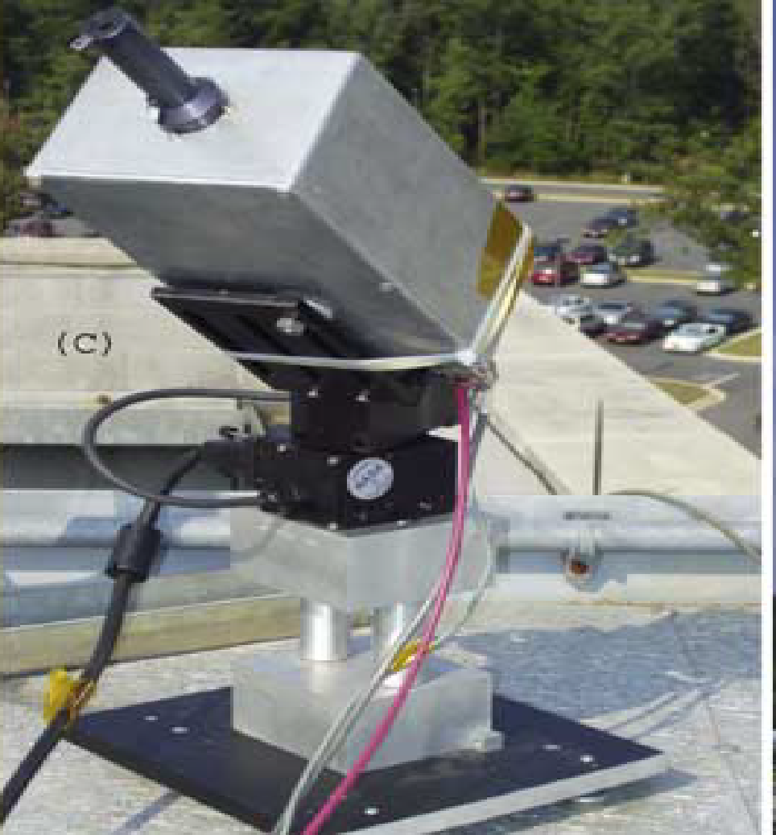
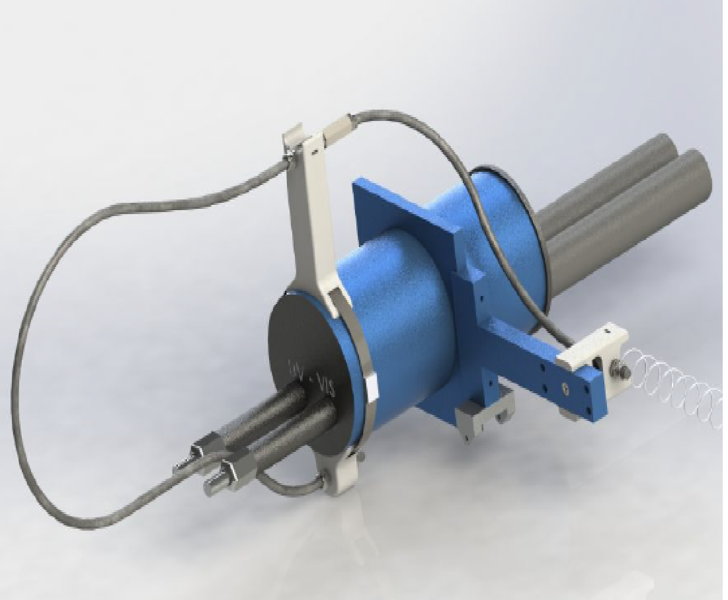
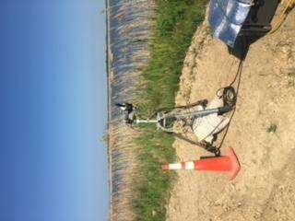
The Pandora Spectrometer System
Pandora version built in 2005
Pandora 2S 2017
Pandora, Hart Miller Island, MD, USA 2018

Slide 4
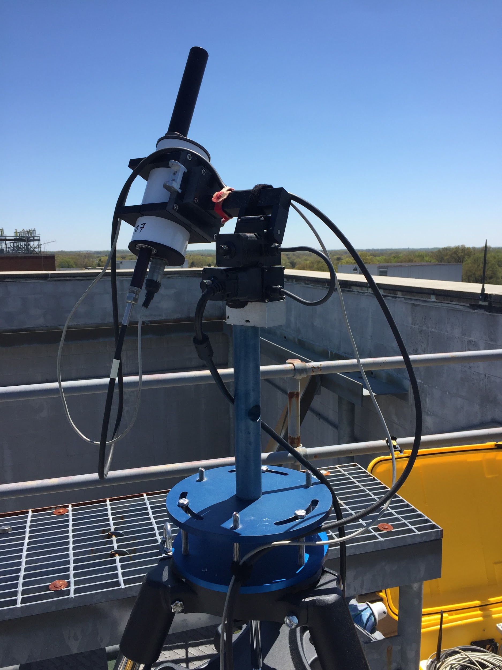
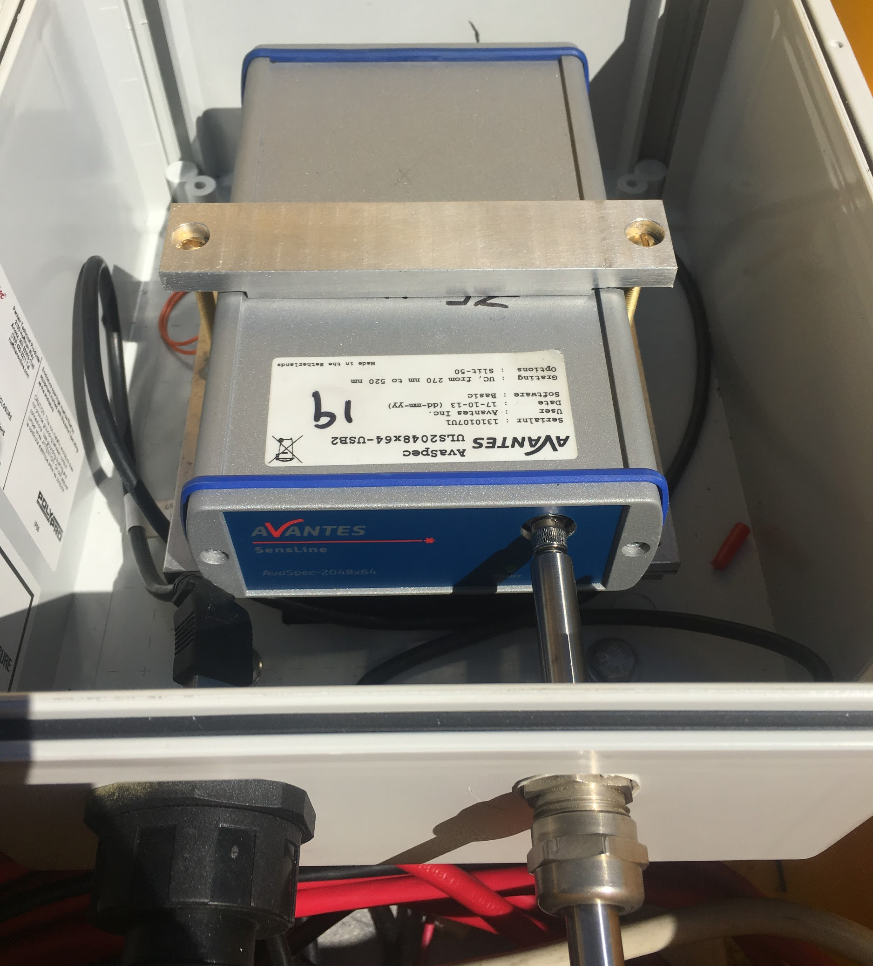
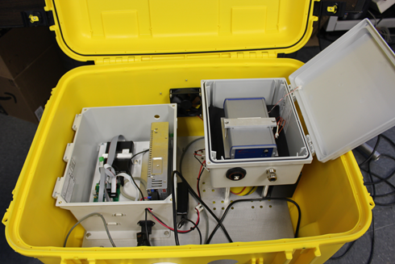
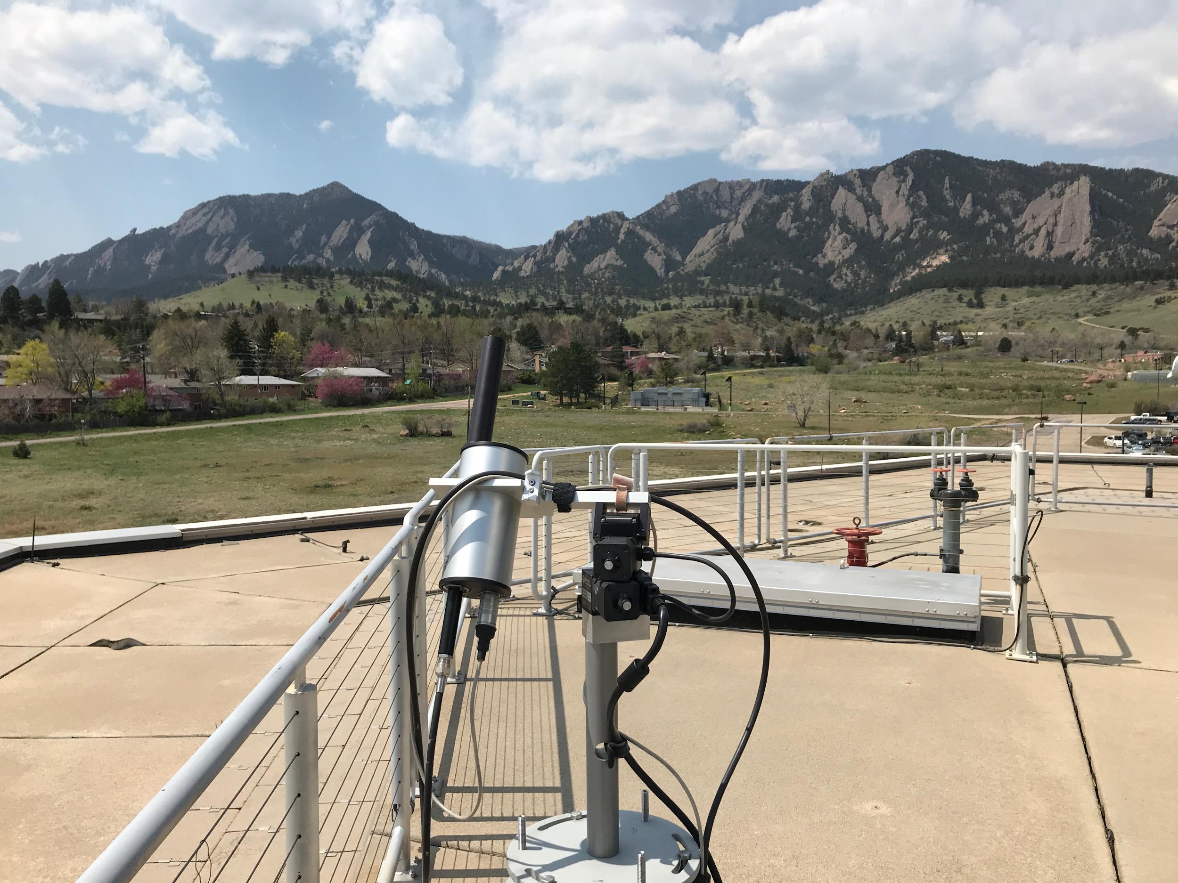
What is the Pandora Spectrometer System?
Small, ground-based Sun/Sky/Lunar observing spectrometer system initiated in 2005 at NASA Goddard Space Flight Center
- (Pandora 1S: 280 – 530 nm, 0.6 nm; 2S: 400 – 900 nm, 1 nm)
NRT Standard Products at high frequency (~ 90 secs.)
- Tot. Column O₃ (+/-15 DU, ~5%); Tot. Column NO₂ (+/-0.05 DU, ~10%)
Additional non-validated products
- HCHO - Total column, trop. & near sfc; NO₂, O₃, SO₂ – trop. & near sfc
Operates autonomously off of line power and wifi; software runs on a small PC found inside the weather resistant container.
Sensor Head
Spectrometer
Pandora Field Box
Boulder, CO

Slide 5
Three Improvements to Hardware

Slide 6
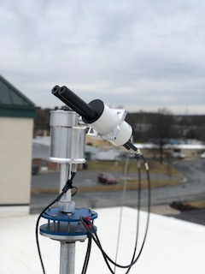
New Improved Tracker Deploying in 2018
Waterproof Housing
Elevation (zenith) Range: 0°- 270°
Azimuth Range: 0°- 370°
0.01° Step, Closed Loop
Improved Communication SW - tracker to PC
Improved Hardware, Optical Encoder, Temp& Error Monitoring, Real time positioning feedback
Possibility to add internal heater for extreme cold wx operations
Higher velocity motion - extremely valuable for moving platforms

Slide 7
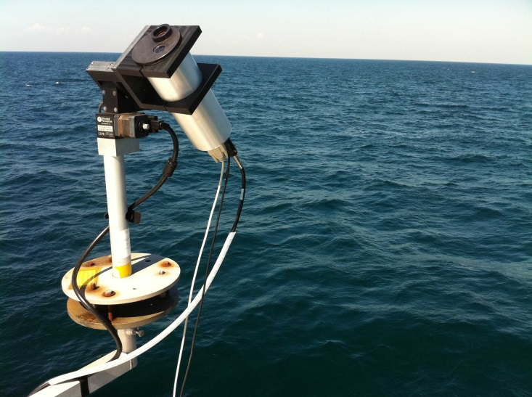
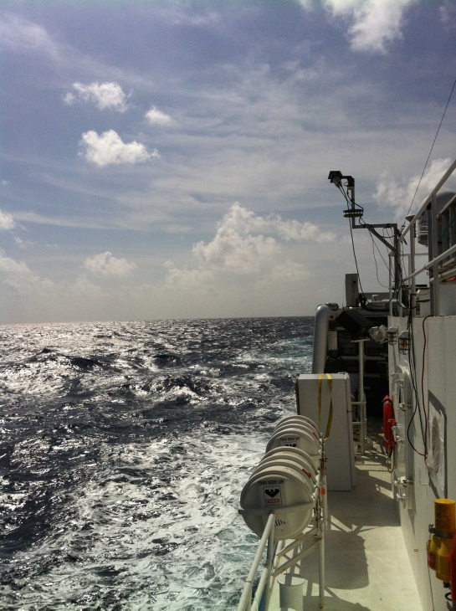
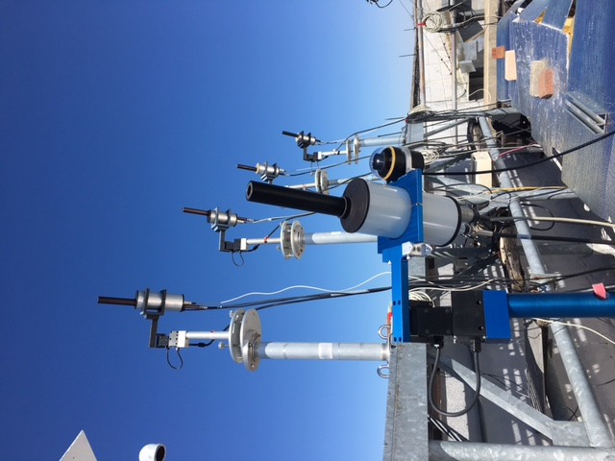
Improved Camera System for Deployment on Ships/Moving Platforms
Uses a Simple Camera System - both internal and external
with ~15 deg FOV to help the instrument with real time sun tracking
Chesapeake Bay
Gulf of Mexico
Notes:
Towers

Slide 8
Instrument Specifications*
Elevation (zenith) Range: 0°- 270°
Azimuth Range: 0°- 370°
Set Temperature Range: 0°-20°C; calibrated at 15° and 20°C
Field of View: 1.5°- 2.4°
Spectral Range: 280 - 530nm
Spectral Resolution: 0.6nm
Power: 120/220V AC
Internet connectivity (Wifi/Wired)
Filter wheel 2:
“Functional” filters
(U340, BP300, DIFF)
Use of Wedged Entrance window vs. anti reflection coating
Optical fiber
(400 μm, multi-mode single core fused silica)
Lense (plano convex)
Filter wheel 1: Attenuation filters (ND1, ND2, ...)
*Configuration of a standard Pandora 1S

Slide 9
From Research/Campaign Mode to Long-Term Monitoring - The Evolution of a Global Network

Slide 10
The Pandonia Global Network (PGN)
Ground-based network - a joint NASA/ESA collaborative effort modeled in the spirit of other networks (e.g. AERONET)
From 2017 onwards, focus primarily on operationalization
Objective: to expand and coordinate a global network of standardized, calibrated instruments and systematically process and disseminate the data to the greater global community in support of in-situ and remotely sensed air quality monitoring

Slide 11
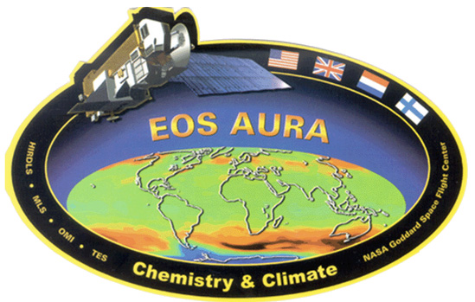
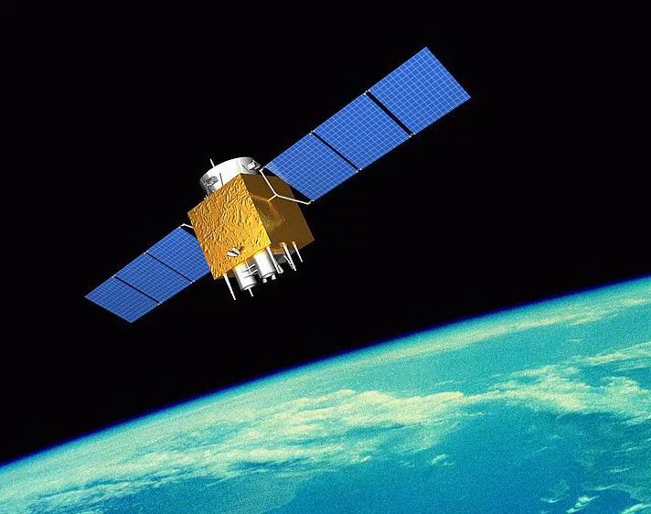
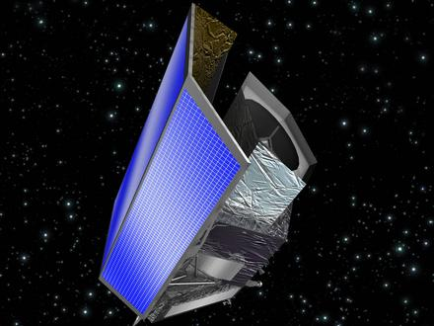
Why is it important?
Support of ESD Science and Satellite Validation/Verification

Slide 12
Current and Future AQ/AC Satellite Missions
Mission | Agency | Launch | Instrument(s) | Synergistic Pandora Observations | Orbit
AURA | NASA | 2004 | OMI | O3, NO2, SO2, HCHO, BrO | LEO
MetOp-A | EUMETSAT | 2006 | GOME-2 | O3, NO2, SO2, HCHO, BrO | LEO
S-NPP | NASA | 2011 | OMPS | O3, SO2 | LEO
MetOp-B | EUMETSAT | 2012 | GOME-2 | O3, NO2, SO2, HCHO, BrO | LEO
DSCOVR | NASA | 2015 | EPIC | O3, SO2 | L1
Sentinel 3A | EUMETSAT | 2016 | MWR, OLCIS, LSTR | H2O | LEO
Sentinel 5P | ESA | 2017 | TROPOMI | O3, NO2, SO2, HCHO | LEO
Sentinel 3B | EUMETSAT | 2018 | MWR, OLCIS, LSTR | H2O | LEO
GaoFen-5 | CSA | 2018 | EMI | O3, NO2, SO2, HCHO | LEO
GEO-KOMPSAT 2 | KMA | 2019 | GEMS | O3, NO2, SO2, HCHO, CHOCHO | GEO
TEMPO | NASA | 2019 | TEMPO | O3, NO2, SO2, HCHO, CHOCHO | GEO
Sentinel 4 | EUMETSAT | 2021 | UVN | O3, NO2, SO2, HCHO | GEO
Senintel 5 | EUMETSAT | 2021 | UVNS | O3, NO2, SO2, HCHO | LEO
MAIA | NASA | TBD | MAIA | SO2, NO2 (aerosol precursors) | LEO

Slide 13
Pandonia Global Network (PGN)
Shared Responsibilities
Network Operations
Calibration, QA/QC
Training of Local Operators
Field Campaigns
Science
NASA Pandora
Responsibilities:
NASA Instrument Builds
Calibration/deployment
Maintenance
Network Operations
Data Mirroring
Managed by: NASA GSFC
ESA Pandonia
Responsibilities:
Software Development
Calibration
Network Operations
Central Processing
Data Serving
Managed by: Luftblick
Notes:
Rigorous evaluation of calibration / performance pre, per and post field - also developing new field calibration tool

Slide 14
NASA/ESA/PGN Accomplishments for past year
STANDARDIZATION and CONVERGENCE:
Summer Intern Training by ESA-Pandonia for NASA GSFC (July ‘17)
NASA/ESA instrument deployment / local operations training (Oct ‘17)
Maturing remote monitoring/support of operations:
instruments, local operators and scientists (Oct-Dec ‘17)
Week-long ESA/NASA PGN Workshop - focus on manual development / harmonization of calibration procedures/data processing / Global Network development (Dec ‘17)
Quick Start Guide for Instrument Set up, local operations and troubleshooting (started in Oct 17’ - ongoing)

Slide 15
NASA/ESA/PGN Accomplishments for past year cont.
Production of 6 scientific manuscripts
Spinei, E. et al. The First Evaluation of Formaldehyde Column Observations by Pandora Spectrometers during the KORUS-AQ Field Study, Atmos. Meas. Tech. Discuss., https://doi.org/10.5194/amt-2018-57 , in review, 2018.
Herman, J. et al.: NO2 and HCHO measurements in Korea from 2012 to 2016 from Pandora Spectrometer Instruments compared with OMI retrievals and with aircraft measurements during the KORUS-AQ campaign, Atmos. Meas. Tech. Discuss., https://doi.org/10.5194/amt-2018-56 , in review, 2018.
Jeong, U et al. (2018). Langley calibration analysis of solar spectroradiometric measurements: Spectral aerosol optical thickness retrievals. Journal of Geophysical Research: Atmospheres, 123. https://doi.org/10.1002/2017JD028262
Sullivan, J. T. et al. The Ozone Water-Land Environmental Transition Study (OWLETS): A Unique Strategy for Understanding Pollution Events within the Chesapeake Bay. Submitted to Bulletin of the American Meteorological Society, March 2018.
Judd, L. et al. (2018). The Dawn of Geostationary Air Quality Monitoring: Case Studies from Seoul and Los Angeles. Submitted to Frontiers in Environmental Science
Gronoff, G. et al. A Method for Observing Near Range Point Source Induced O3 Titration Events Using Co-located Lidar and Pandora measurements. Atmospheric Measurement Techniques. Submitted April 2018

Slide 16
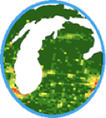
Support of Recent NASA/ESA/PGN Field Campaigns
Notes:
Images
Layout of OWLETS field campaign, SARP-E involvement, SERC
Inter-conversion/Titration Event w/ schematic, plots, etc

Slide 17
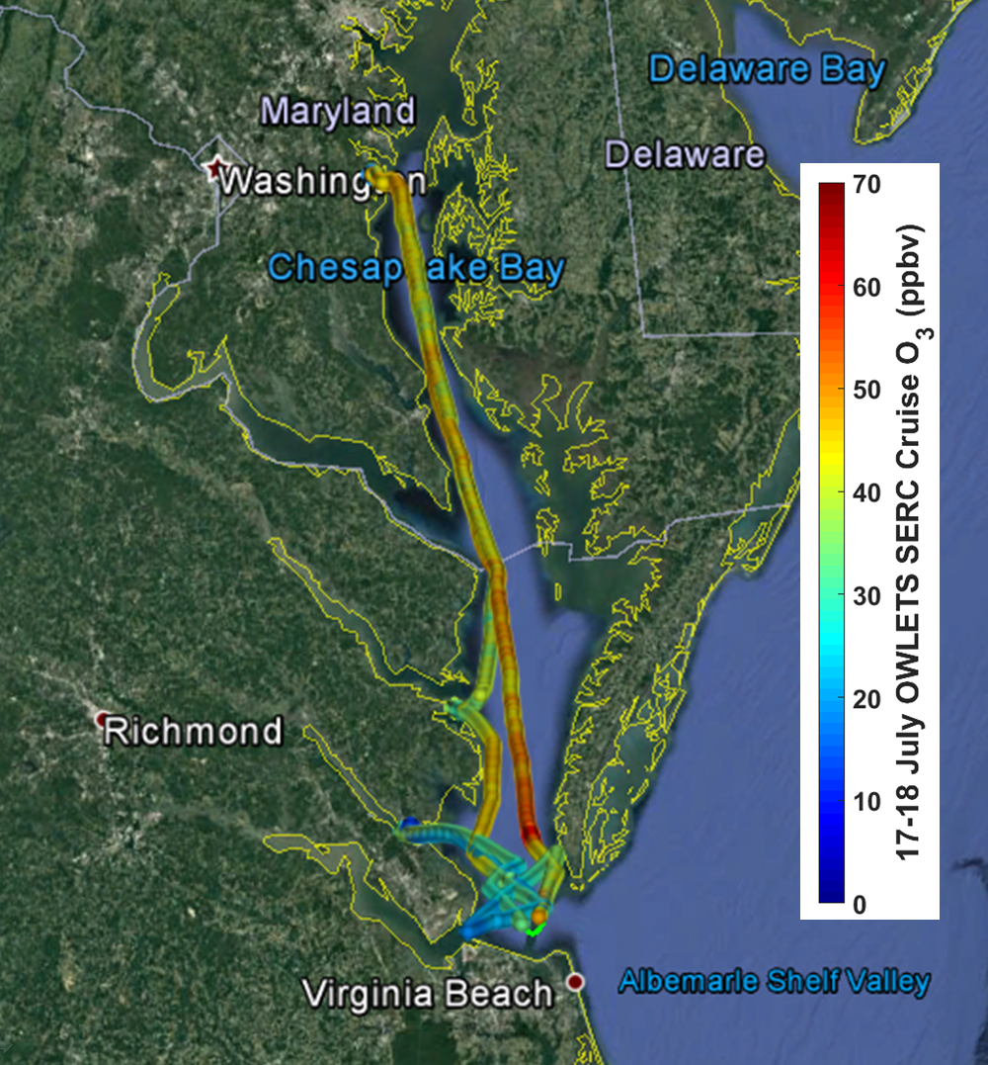
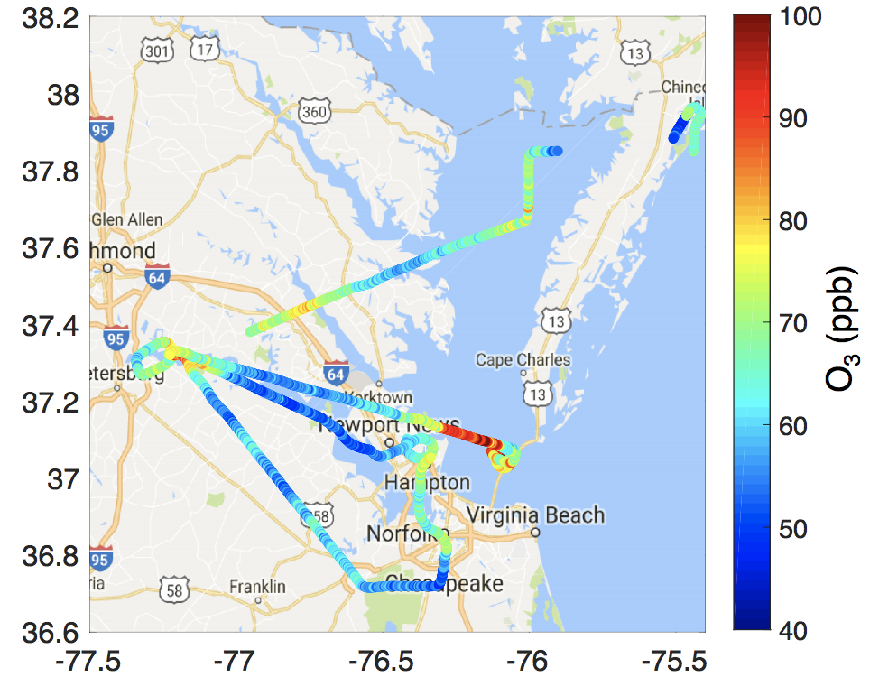
OWLETS Overview
SERC RV
NASA C-23 Sherpa
07/17 & 07/18 in-situ Ozone
07/20 Ozone (≤ 500 m ASL)

Slide 18
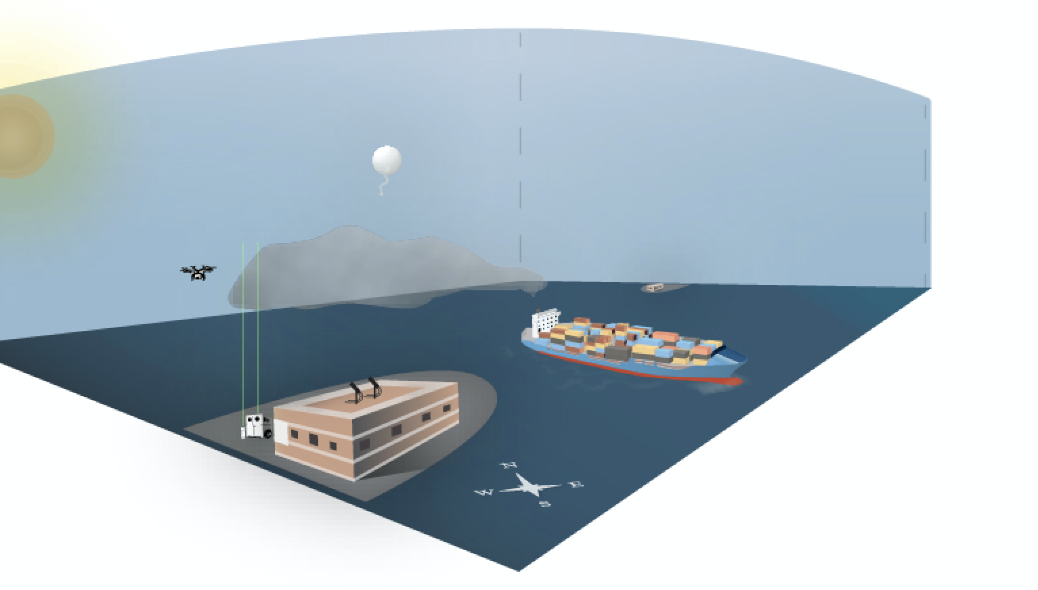
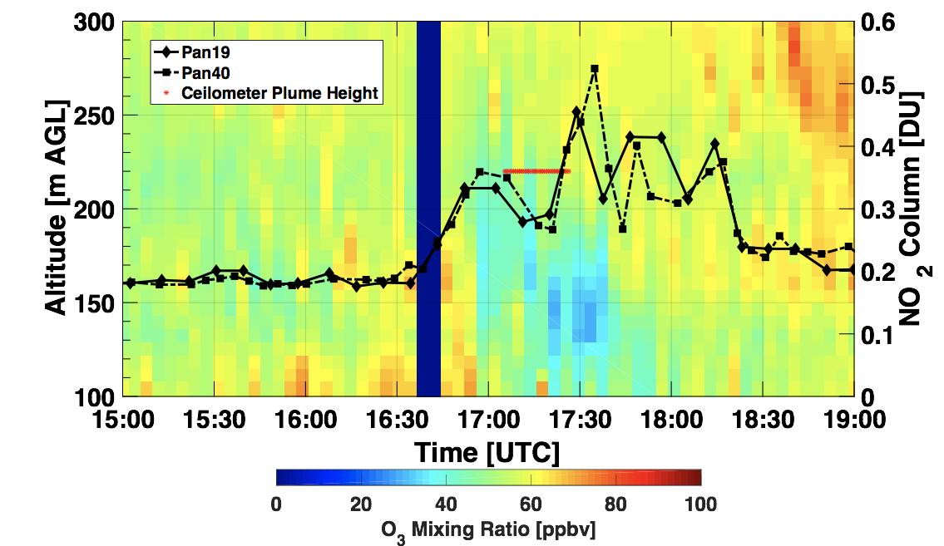
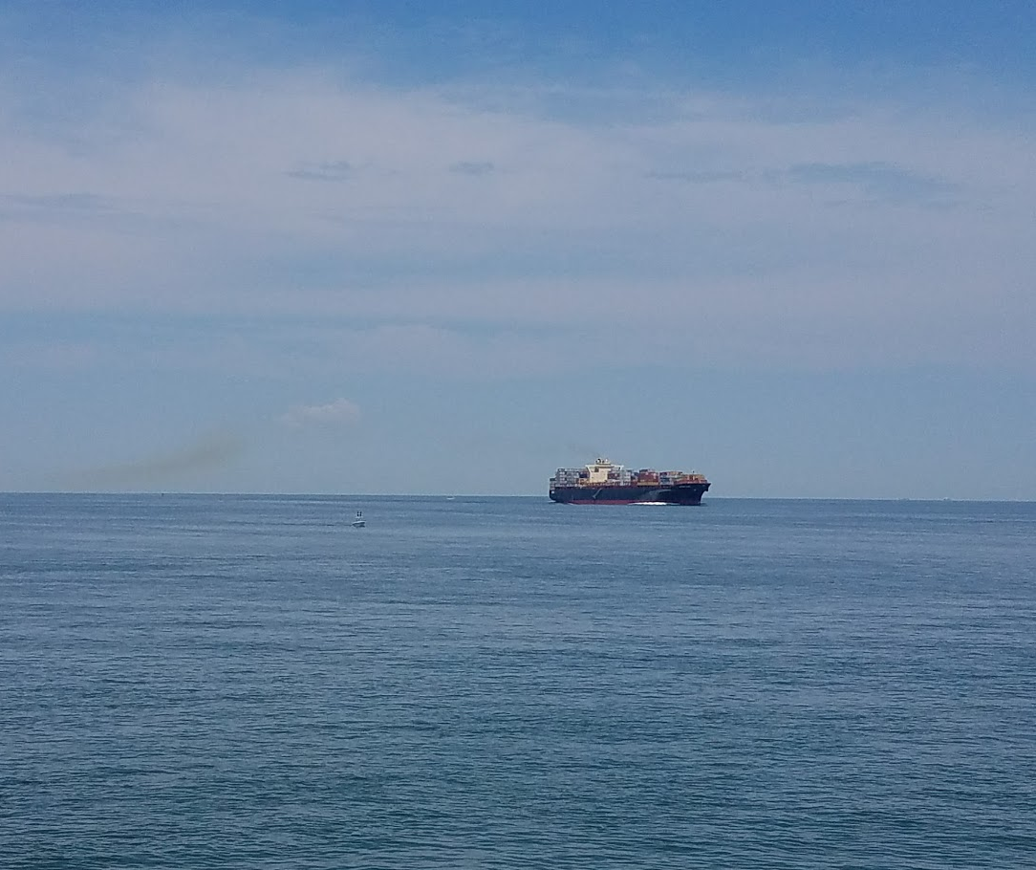
Interconversion/Titration Event
NO + O₃ ---> NO₂ + O₂
<---
TOL, Pandora & Ceilometer, Aug. 1, 2017
*Credit to Lindsey R. F. Hendrick, VCU CES

Slide 19
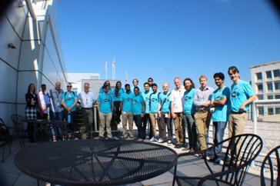
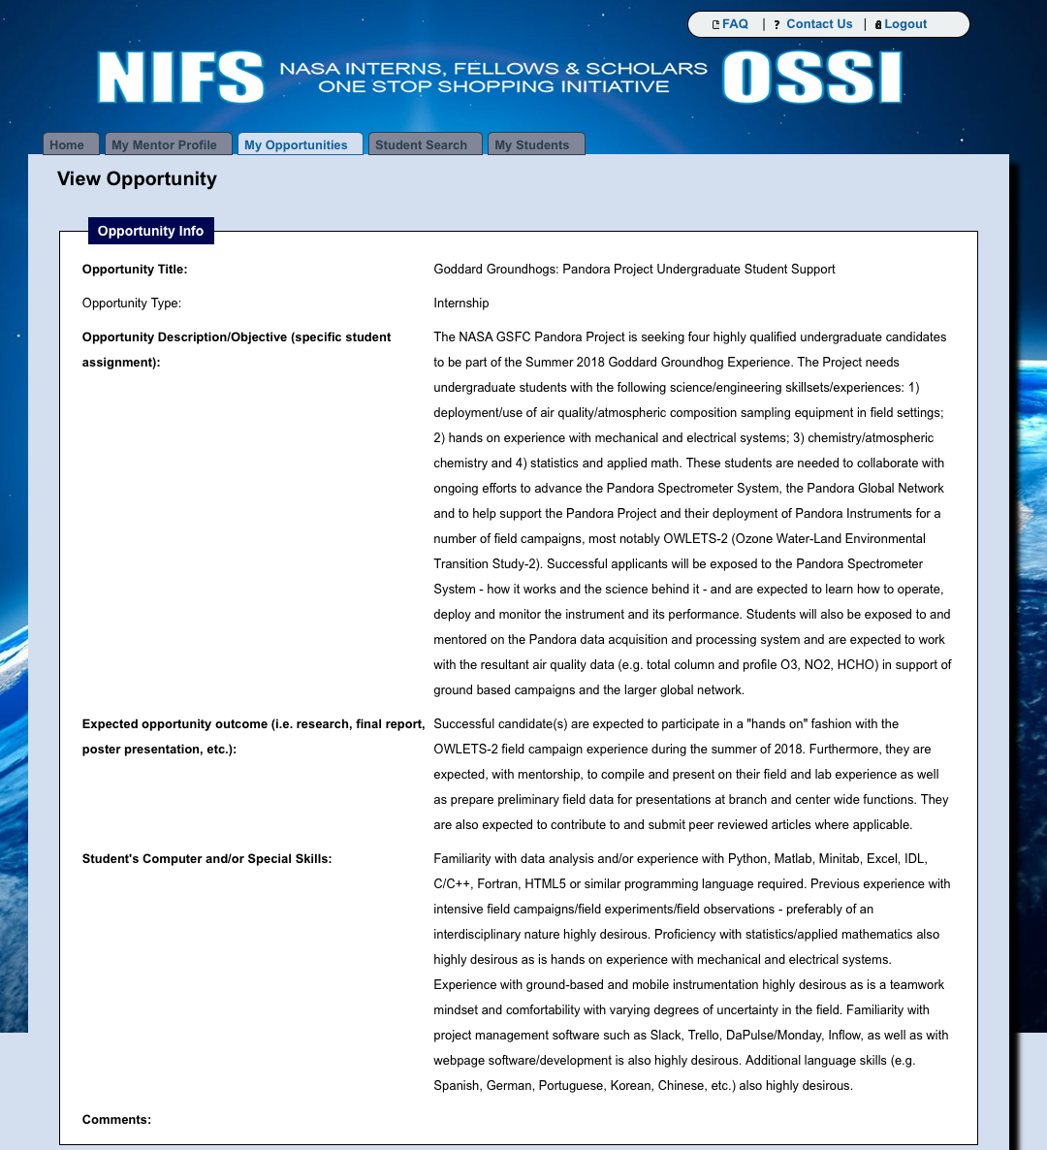
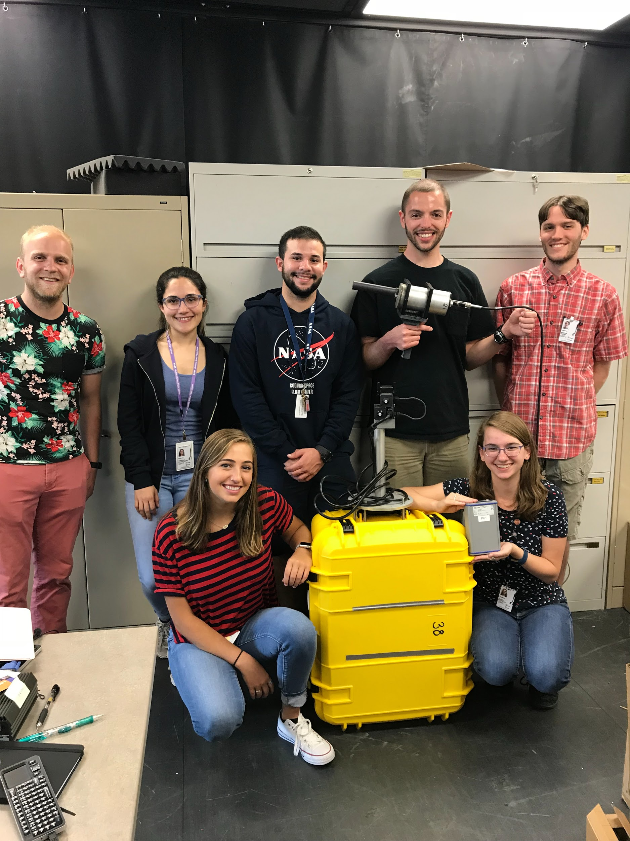
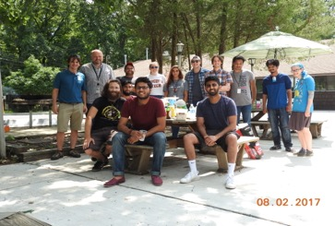
“Growing Our Own Timber”:
Grooming the Next Gen of ES Scientists

Slide 20
Campaign to Long Term Fixed Deployments:
Summer 2018

Slide 21
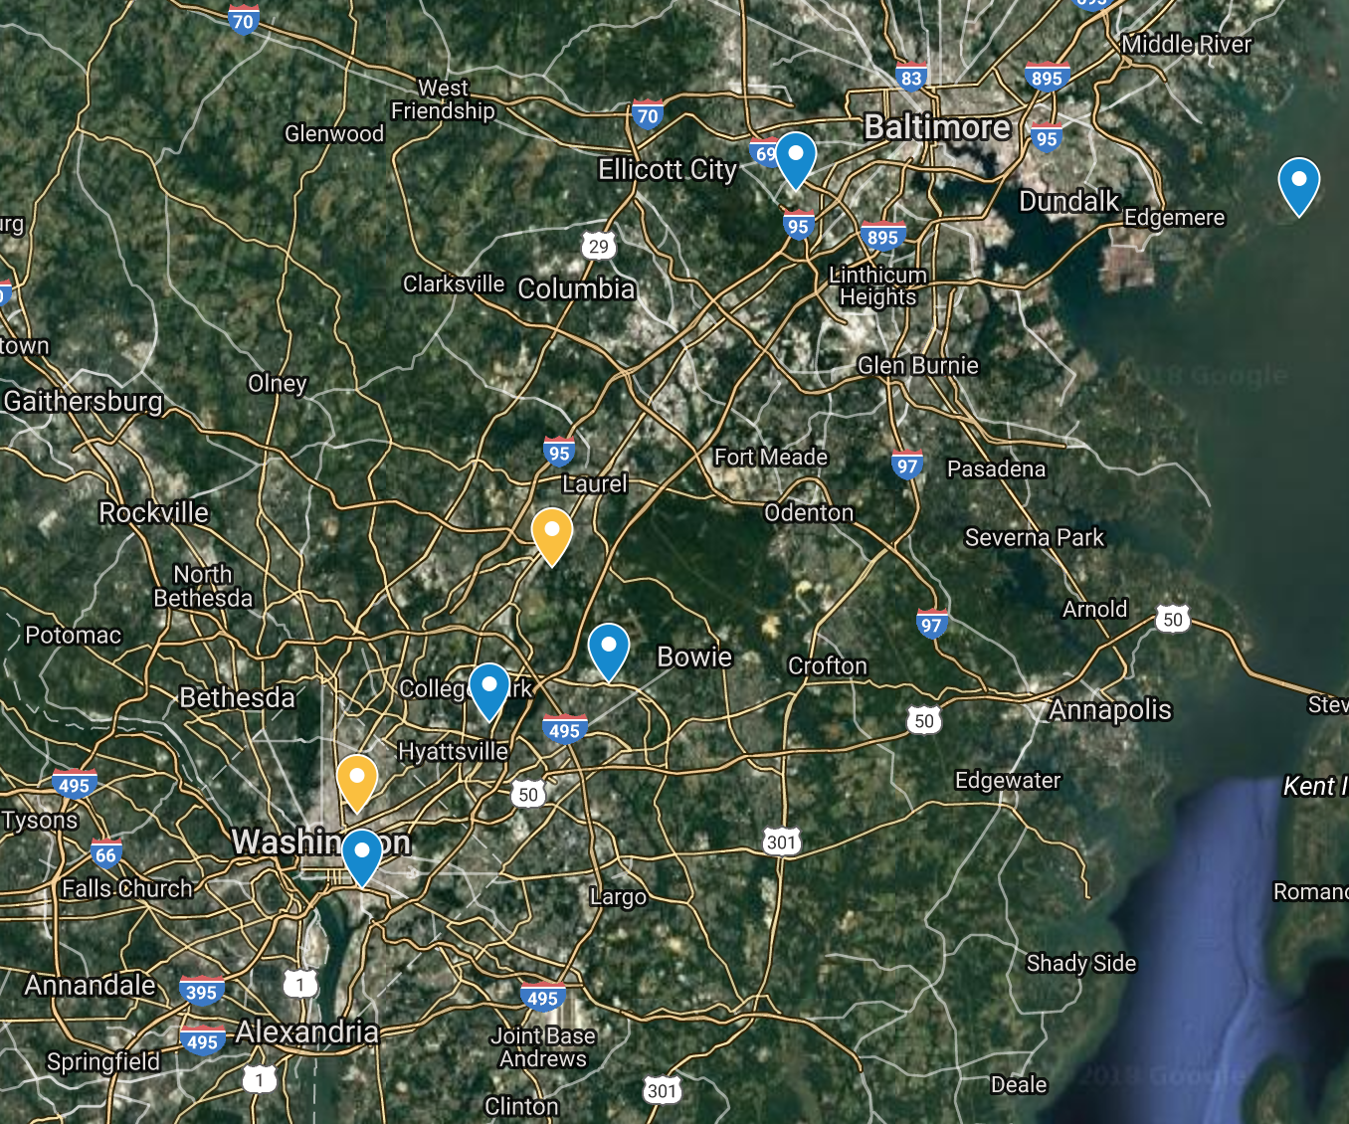
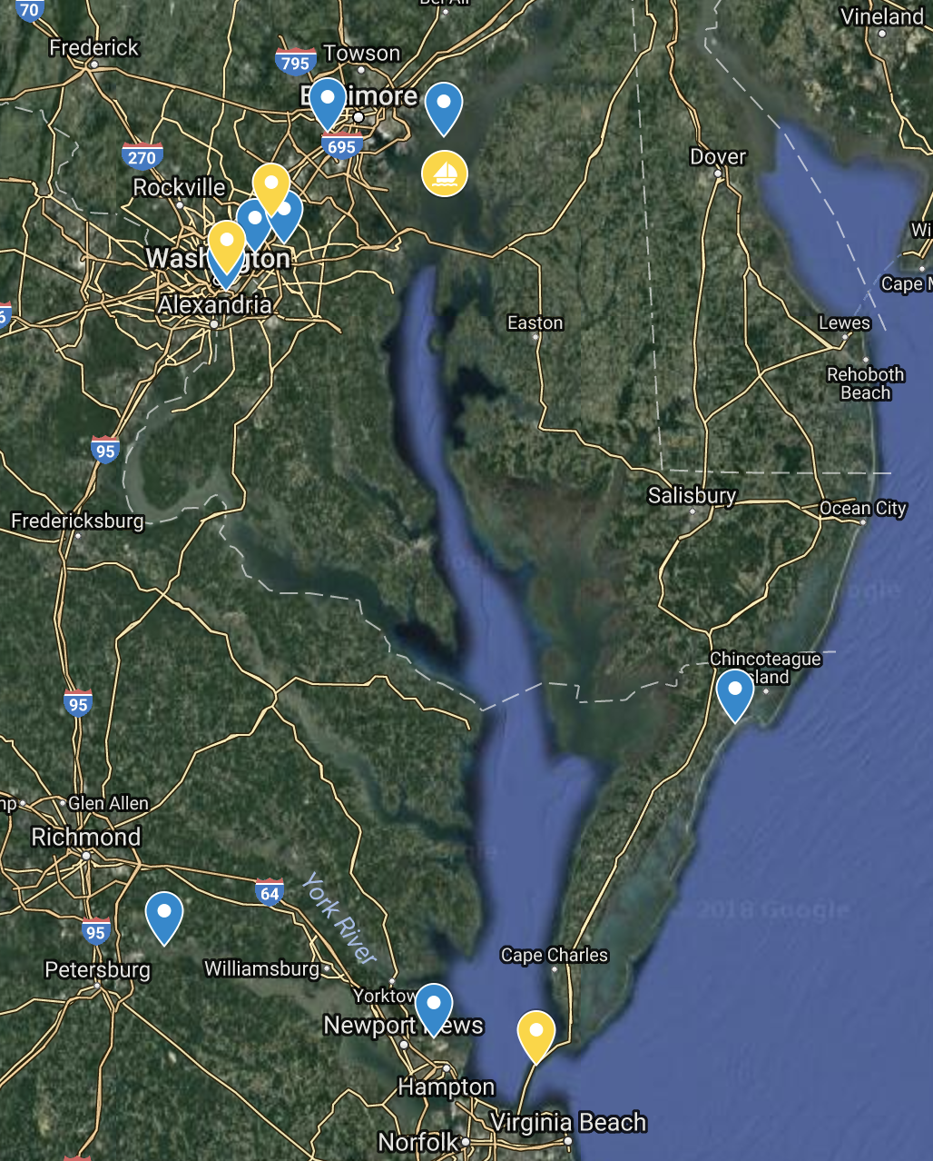
OWLETS-2
Mid-Atlantic Deployments
TBD
GSFC
TBD
12 Pandoras Deployed
100 km

Slide 22
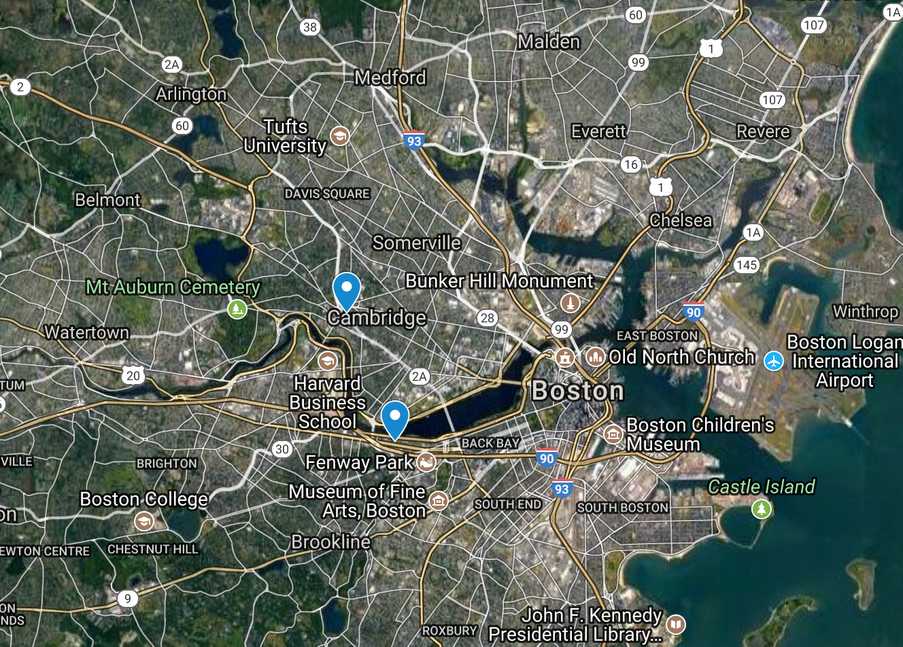
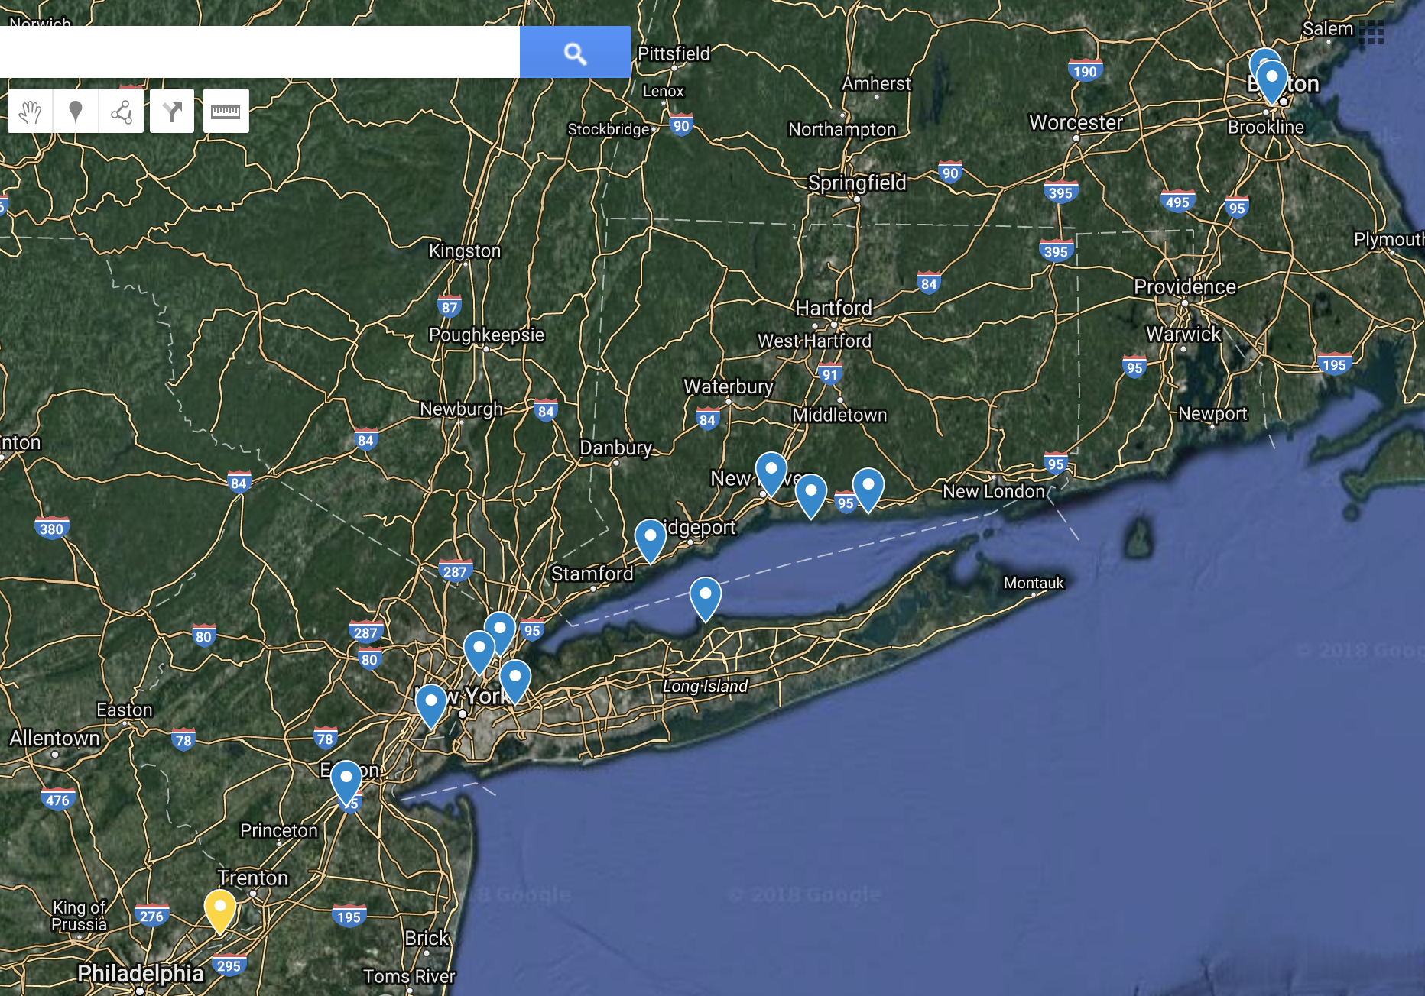
LISTOS
North East Deployments
SAO
BU
13 Pandoras Deployed
100 km

Slide 23
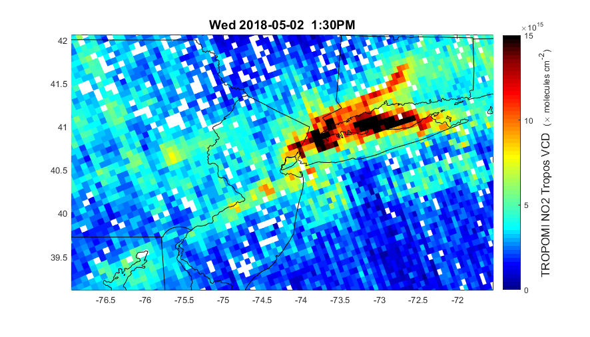
Rationale for LISTOS Site Selection

Slide 24
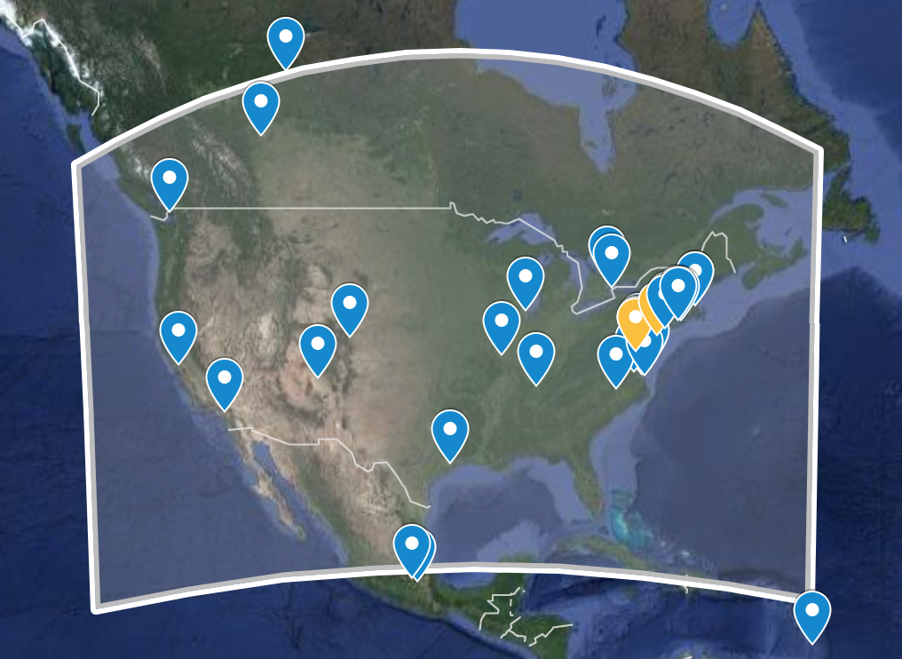
N. American Distribution of Pandoras (n=45)

Slide 25
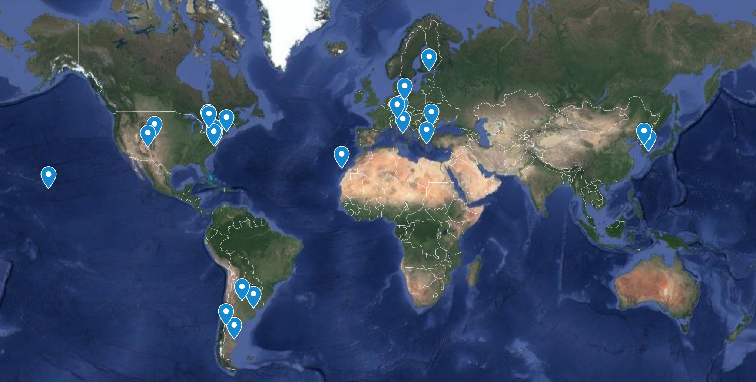
Global Distribution of Pandora’s 2016

Slide 26
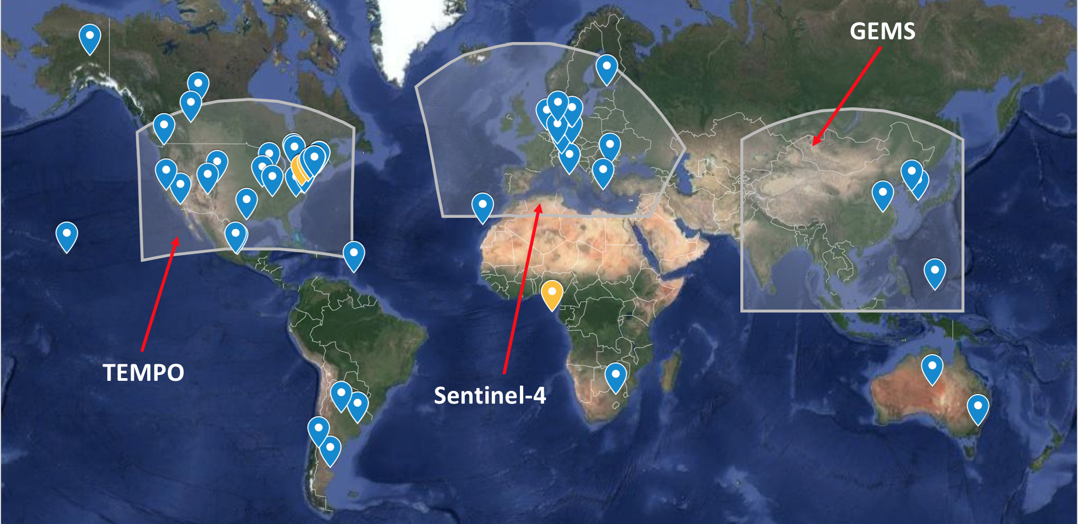
Global Distribution of Pandora’s, June 2018
73 Instruments active globally with another 15 to be delivered in 2018
~42 monitored by NASA GSFC Pandora, ~31 by ESA-Pandonia
Possibility to provide hourly observations of O₃, NO₂, SO₂, HCHO from GEO is a major advancement for air quality (vs LEO 1x/day )
By year end min. 50 NASA owned instruments deployed and operational

Slide 27
Goals for this year
Establishment of international site agreement template where expectations articulated in draft PGN Site Information Form to be released mid-Summer
Collaborative evaluation/development of new and existing operational algorithms
Maturing the remote monitoring and support of operations: instruments, local operators and scientists
Launch of collaborative PGN website (est. mid-July)
AGU Special Session (Observations and Modeling of Air Quality at Land-Water Boundaries, session ID#51995) with possible side meeting
Science Workshop on Pandora - TBD - possibly in conjunction w AGU
Continued collaboration w TOLNET, AERONET, MPLNET
Continued expansion of the NASA Pandora, leveraging ancillary observations at local, state and fed DEQ/EPA AQ monitoring sites

Slide 28
Thank you.
For more information please contact:
robert.j.swap@nasa.gov

